Slide 1


COMP507 IT Project Management Schedule Management
Daniel

Slide 2
Learning Objectives
Use Gantt chart concepts for planning and tracking the schedule of a project (executing, M/C) – So great for reporting.
Use milestones in projects (planning, m/C)
Find the critical path for a project, (planning, monitoring and controlling)
Explore the use of the Program Evaluation and Review Technique (PERT) to
schedule development (planning/ M/C)
Describe how project management software can assist in project time management

Slide 3
Project Schedule Management Processes
Three key processes:
1. Planning schedule
Defining activities (Based on WBS): identifying the specific activities that the project team members and stakeholders must perform to produce the project deliverables
Estimating activity durations: estimating the time needed to complete individual activities
Sequencing activities: identifying and documenting the relationships between activities
Estimating activity resources: estimating how many resources a project team should use to
perform activities
Developing the schedule: based on activities, their sequences, and estimated durations, including their resource estimates, create the project schedule.
2. Set the baseline to execute the schedule (google how to set the baseline)
3. Controlling the schedule: controlling and managing changes to the project schedule

Slide 4
Planning Schedule Management
To plan and work according to the schedule need a schedule management plan
A schedule management plan includes:
Project schedule model development: (the WBS)
project activities, estimates, dependencies, and other planning information
The scheduling methodology
Critical path, milestones
Level of accuracy and units of measure
How accurate are the estimates to be: hours, day, or another unit
Control thresholds
Variance threshold for monitoring schedule performance
Rules of performance measurement
Must set a baseline - to show work done every day/week/month - reporting.
Critical path, milestones for monitoring and control
Earned Value Management (EVM) can be used
Reporting formats
format and frequency of reports

Slide 5
WBS- Defining Activities/Task
WBS provides a model to break the project work into phases and individual pieces of independent work known as activity or task
An activity or task, called a work package an expected duration, cost, and resource requirements
1. Planning phase (a phase in the project)
1.1 Project initiation (a main task but broken into sub-tasks. It is an independent task compared to a task at its level i.e., 1.2. the duration
1.1.1 stakeholder register (a sub-task or a work package, independent of the two sub-tasks and will have a duration, cost, and resource requirement)
1.1.2 project charter ((a sub-task or a work package that will have a duration, cost, and resource requirement)
1.1.3 Business case (a sub-task or a work package that will have a duration, cost, and resource requirement)
1.2 Develop project plans
1.2.1 stakeholder management strategy
1.2.2 risk register
1.2.3 issue register
1.2.4 business cases
The project initiation task, its duration will be the total time taken to do its three sub-tasks; the same applies to the cost and resources requirements
For the phase- the total duration will be all the durations of its tasks added together. The same applies to the cost and resources

Slide 6
Activity/Task List and Attributes
Activities/tasks must have
the activity name
an activity identifier or number (MS Project assigns the number automatically)
a brief description of the activity
Activity attributes provide more information such as predecessors, successors, logical relationships, leads and lags, resource requirements, constraints, imposed dates, and assumptions related to the activity
Vital in sequencing and re-sequencing your project
. Planning phase
1.1 Project initiation (activity number, activity name)
1.1.1 stakeholder register
1.1.2 project charter (1.1.2 done at the same time or after 1.1.1? if after than 1.1.1 is a predecessor task to task 1.1.2)
1.1.3 Business case (1.1.2 can be a predecessor to 1.1.3)

Slide 7
Milestones
A milestone is a significant event that normally has no duration
It often takes several activities and a lot of work to complete a milestone
Milestones are useful tools for setting schedule goals and monitoring progress
Example- you can set a milestone based on completing the project initiation tasks. You can have more than one milestone in a phase
1.1 Project initiation
1.1.1 stakeholder register
1.1.2 project charter
1.1.3 Business case
Milestone 1 initiation tasks completed
(Milestone date will be shown based on your tasks scheduled in MS Project)

Slide 8
Three types of Dependencies
Mandatory dependencies: inherent in the nature of the work being performed on a project, sometimes referred to as hard logic
Discretionary dependencies: defined by the project team. Sometimes referred to as soft logic and should be used with care since it may limit later scheduling options
External dependencies: involve relationships between project and non-project activities
Need to have a good understanding of WBS item characteristics

Slide 9
Network Diagrams
Network diagrams are the preferred technique for showing activity sequencing
A network diagram is a schematic display of the sequencing of activities/tasks in projects.
Two main formats are the Activity on Arrow (AoA) and Precedence DiagramMethod (PDM)

Slide 10
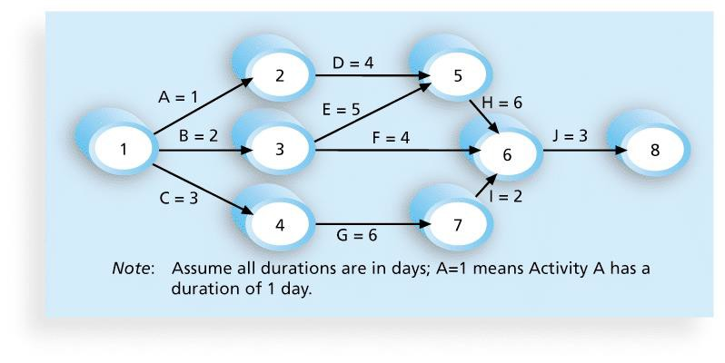
Figure 6-2. Network Diagram for Project X

Slide 11
Arrow Diagram Methods (ADM)
Also called Activity on Arrow (AOA) network diagrams
Activities are represented by arrows
Nodes are the starting and ending points of activities
Can only show finish-to-start dependencies

Slide 12
Process for Creating AOA Diagrams
Draw node 1. Find all of the activities that start at node 1. Draw their finish nodes and draw arrows between node 1 and those finish nodes. Put the activity letter or name and duration estimate on the associated arrow (not the node)
Continuing drawing the network diagram, working from left to right. Look for bursts and merges. Bursts occur when a single node is followed by two or more activities. A merge occurs when two or more nodes precede a single node
Continue drawing the network diagram until all activities are included on the diagram that have dependencies
As a rule of thumb, all arrowheads should flow toward the right, and no arrows should cross over on an AoA network diagram

Slide 13
Precedence Diagram Method (PDM)
In precedence diagram activities are represented in boxes
Arrows show the relationships between activities
Typically more popular than arrow diagram methods (ADM) and used in project management software
Precedence diagram is considered to be better at showing different types of dependencies

Slide 14
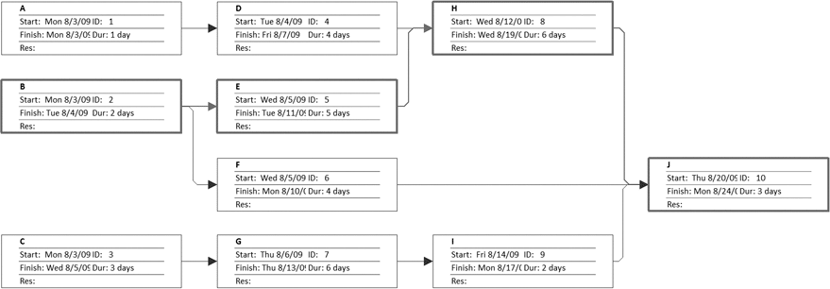
Figure 6-4. Sample PDM Network Diagram

Slide 15
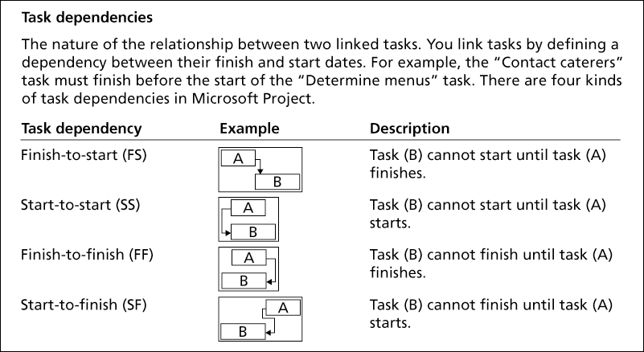
Figure 6-3. Task Dependency Types

Slide 16
Three-Point Estimates
Instead of providing activity estimates as a discrete number, such as
four weeks, it’s often helpful to create a three-point estimate
an estimate that includes optimistic (shortest), most likely, and pessimistic (longest) estimates, such as three weeks for the optimistic, four weeks for the most likely, and five weeks for the pessimistic estimate - a range in effect
Three-point estimates are needed for Program Evaluation and Review Technique (PERT)
PERT is used to estimate project duration when there is a high degree of uncertainty about the individual activity duration estimates

Slide 17
PERT Formula and Example
PERT weighted average =
optimistic time + 4X most likely time + pessimistic time
6
Example:
PERT weighted average =
8 workdays + 4 X 10 workdays + 24 workdays
6
where optimistic time= 8 days most likely time = 10 days, and pessimistic time = 24 days
= 12 days
Therefore, you’d use 12 days on the network diagram instead of 10 when using PERT for the above example

Slide 18
Developing the schedule itself
The ultimate goal is to create a realistic project schedule that provides a basis for monitoring project progress for the time dimension of the project
Important tools and techniques include Gantt charts, critical path analysis, and Program Evaluation and Review Technique (PERT) analysis

Slide 19
Gantt Charts
Gantt charts provide a standard format for displaying project schedule information by listing project activities and their corresponding start and finish dates in a calendar format
Common symbols include:
A black diamond: a milestones
Thick black bars: summary tasks
Lighter horizontal bars (often in blue): durations of tasks
Arrows: dependencies between tasks

Slide 20
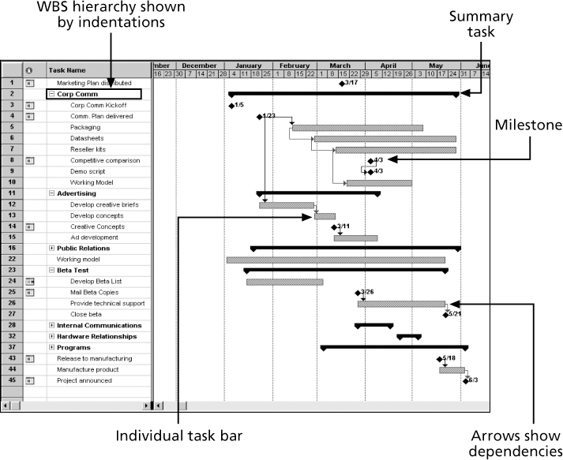
Figure 6-6. Gantt Chart for Software Launch Project

Slide 21
Adding Milestones to Gantt Charts
Many people like to focus on meeting milestones, especially for large projects (often these are Key Performance Indicators)
Milestones emphasize important events or accomplishments on projects
Normally you create a milestone by entering tasks with a zero duration, or you can mark any task as a milestone in the menu

Slide 22
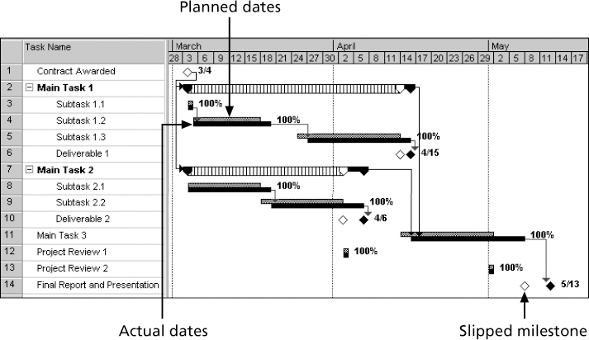
Figure 6-7. Sample Tracking Gantt Chart

Slide 23
Critical Path Method (CPM)
CPM is a network diagram technique used to predict total project duration
A critical path for a project is the series of activities that determines the earliest time by which the project can be completed
The critical path is the longest path through the network diagram and has the
least amount of slack or float
Slack or float is the amount of time an activity may be delayed without delaying a succeeding activity or the project finish date
Activities that fall on the critical path must be started on time and finished on time, otherwise it will delay other tasks and the overall completion of the project.

Slide 24
Calculating the Critical Path
First develop an effective network diagram
Add the duration estimates for all activities on each path through the network diagram
The longest path from beginning to end is the critical path
If one or more of the activities on the critical path takes longer than planned, the whole project schedule will slip unless corrective actions are taken
Sometimes that could mean staff working overtime, adding more staff to a project, outsourcing aspects rather than in-house, pulling resources from other projects (potentially delaying them)
Pulling back on quality or on scope

Slide 25
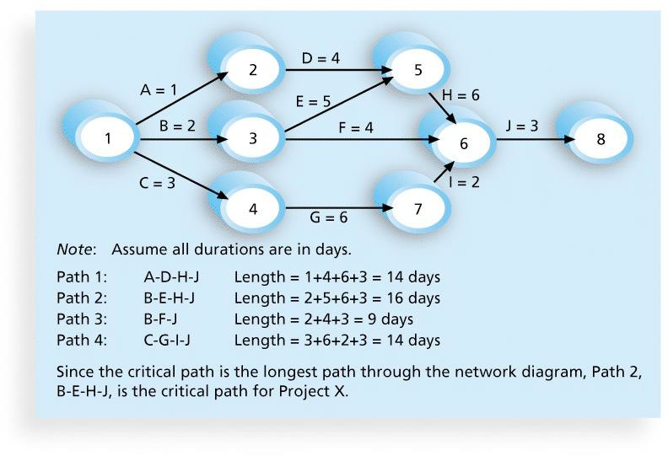




Figure 6-8. Determining the Critical Path for Project X

Slide 26
More on the Critical Path
The critical path is not the one with all the critical activities; it only accounts for time
There can be more than one critical path if the lengths of two or more paths are the same
The critical path can change several times as the project progresses

Slide 27
Using Critical Path Analysis to Make Schedule Trade-offs
Free slack or free float is the amount of time an activity can be delayed without delaying the early or on-time start of any immediately following activities
Total slack or total float is the amount of time an activity may be delayed from its early or on-time start without delaying the planned project finish date
A forward pass through the network diagram determines the early start and finish dates
A backward pass determines the late start and finish dates

Slide 28
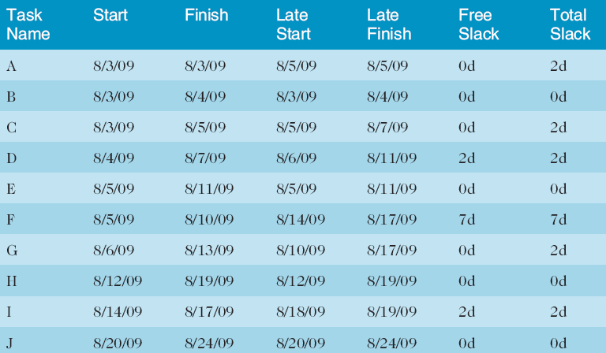
Table 6-1. Free and Total Float or Slack for Project X

Slide 29
Controlling the Schedule
Tools and techniques include
Critical path, Milestone reports
Progress reports
A schedule change control system
Project management software, including schedule comparison charts like
the tracking Gantt chart
Variance analysis, such as analysing float or slack
Performance management, such as Earned Value Analysis (EVA)

Slide 30
Summary
Project schedule management is often cited as the main source of conflict on projects, and most IT projects exceed initial time estimates
Main processes include
Plan schedule management
Define activities
Sequence activities
Estimate activity resources
Estimate activity durations
Develop the schedule
Control the schedule

Slide 31
Homework
Before next week’s class Chapter 10 from Information Technology Project Management (2019) by Kathy Schwalbe
Start your Assignment 1 Part 2 and submit your Part 1 on Canvas

